Slide 1
HPE - Athletic Development
Year 9 and 10

Slide 2
Athletic Development
This course provides motivated students with an athlete development program based around individual needs. Students will be provided with a balance of applied knowledge to complement their sport specific training they are engaged with out of hours.
Athletic Development is a 2 year course (can be done in Year 9 and 10) that is intended to engage athletes who are wishing to get the best out of themselves physically. Students need to be highly motivated and should be receiving good marks in HPE leading into choosing this subject.

Slide 3
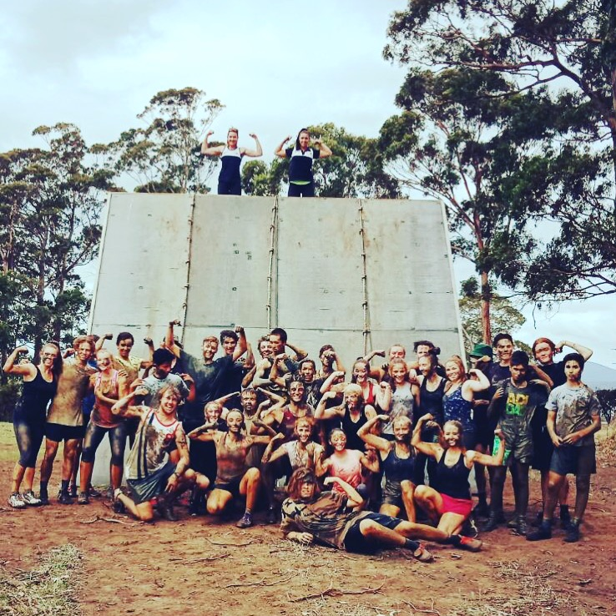
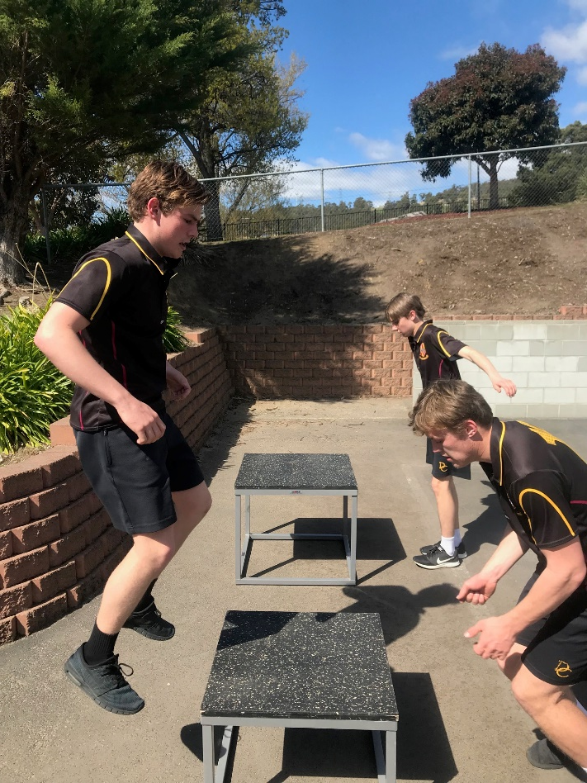
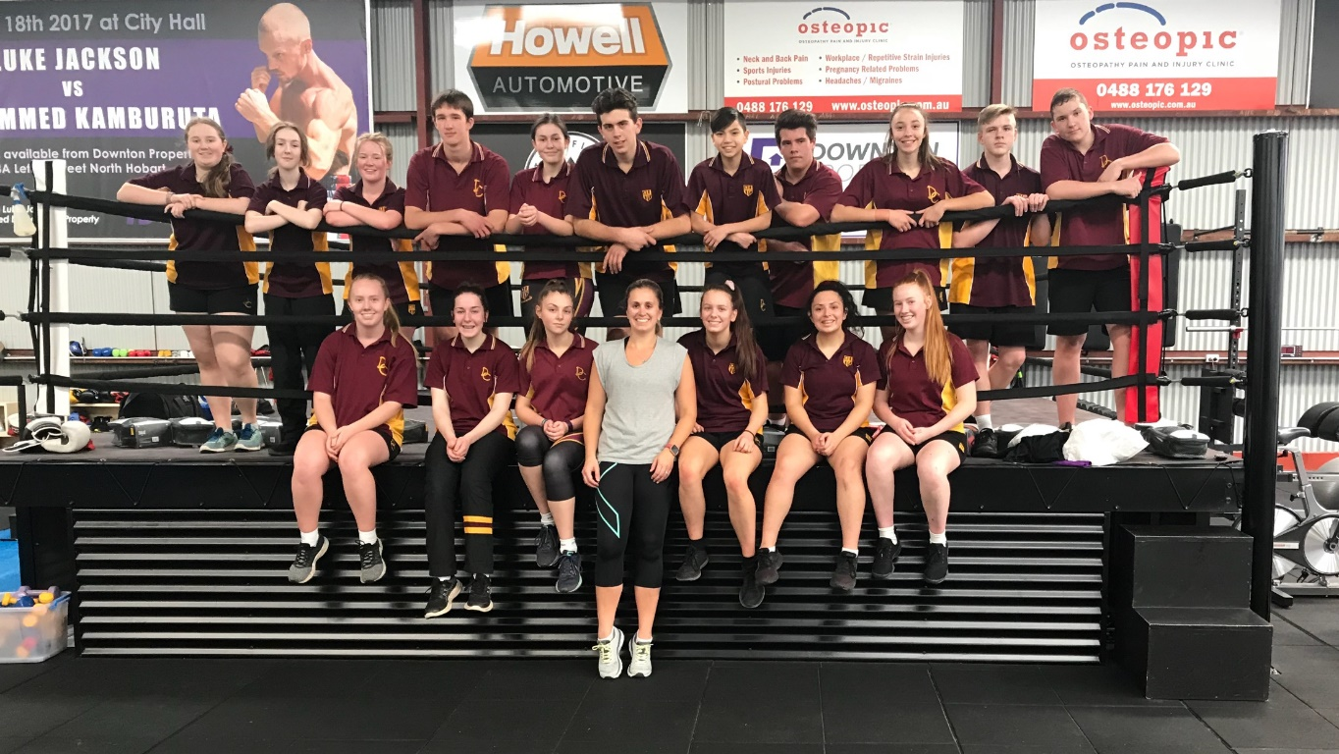
Athletic Development includes:
2-4 hrs of extra physical education and fitness development per week.
Fitness tests every 8 weeks
Classes undertake a variety of fitness sessions both at Dominic College and externally

Slide 4
Why Should I take Athletic Development
Students in this subject should want to improve all aspects of their athletic performance. Athletic Development allows students to push themselves to the next level physically. Students will work on a variety of training types and methods to broaden their knowledge and understanding. This is a highly practical subject that is engaging for students who want to work hard and see improvement in a number of physical areas.

Slide 5
Athletic Development Careers
Sports Coaching
Sport and Recreational Programs
Fitness Training
Professional Sports
Sports Management
Sport Psychology
Sports Administration
Nutrition
Physical Education Teacher
Physiotherapy
Exercise physiology
Personal Training

Slide 6
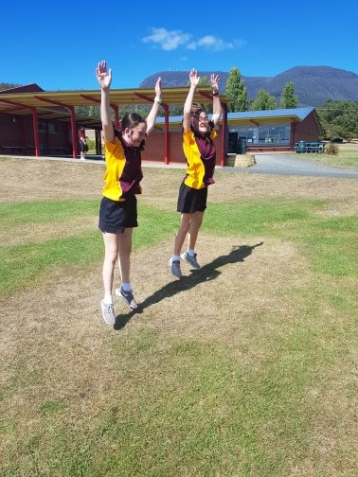
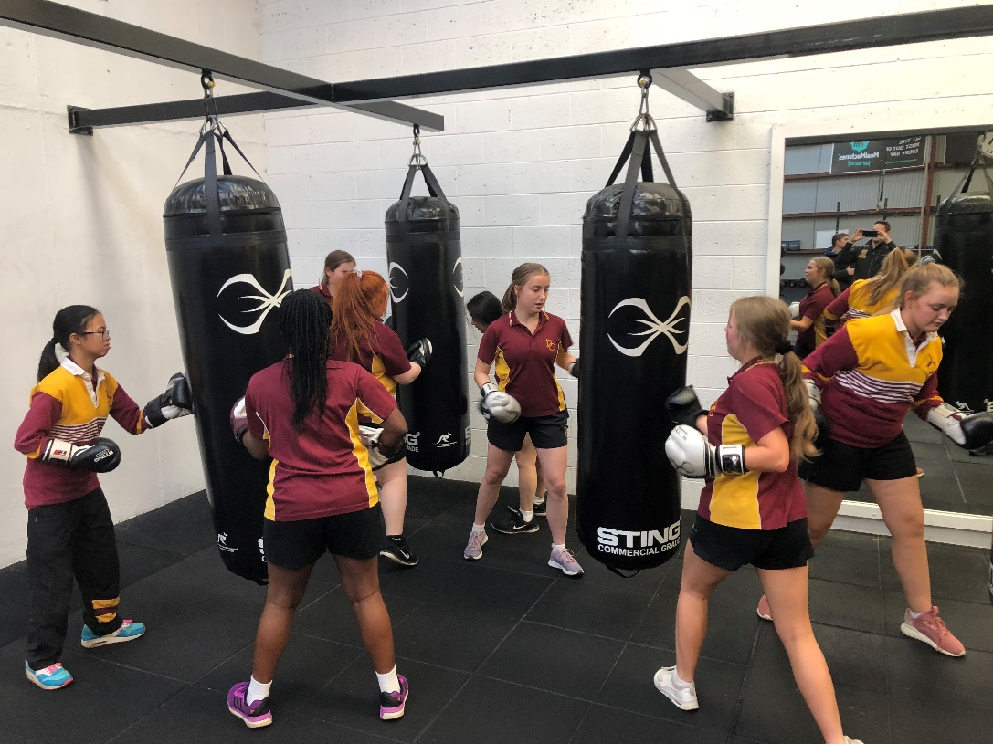
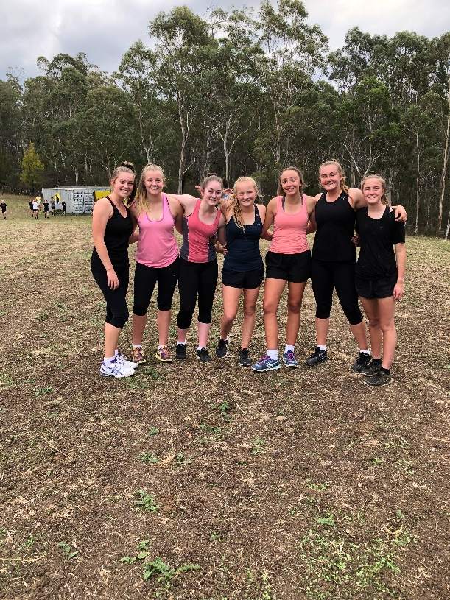
Topics Covered – Year A
Theory:
Fitness components and testing
Training types and methods
Goal setting and motivation
Nutrition
Practical:
Various fitness testing methods across all components
Application of types of training
Opportunity to develop and run your own training session

Slide 7
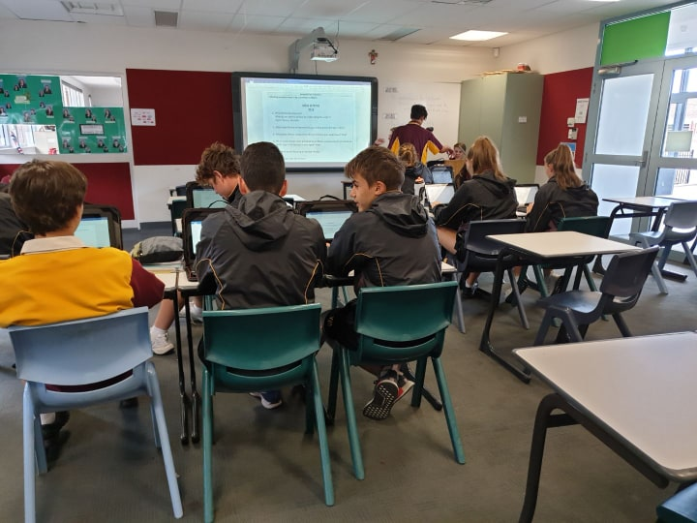
Topics Covered - Year B
Theory:
Principles of Training
Basic Skeletal and Muscular Anatomy and Physiology
Planning for success- fitness session and facilitation
Planning and implementation on individualized, goal focused fitness programs
Self Analysis and program Re-Evaluation
Practical:
Application of various types of training
Application of Principals of training
Development and implementation of 8 week individualized training program

Slide 8
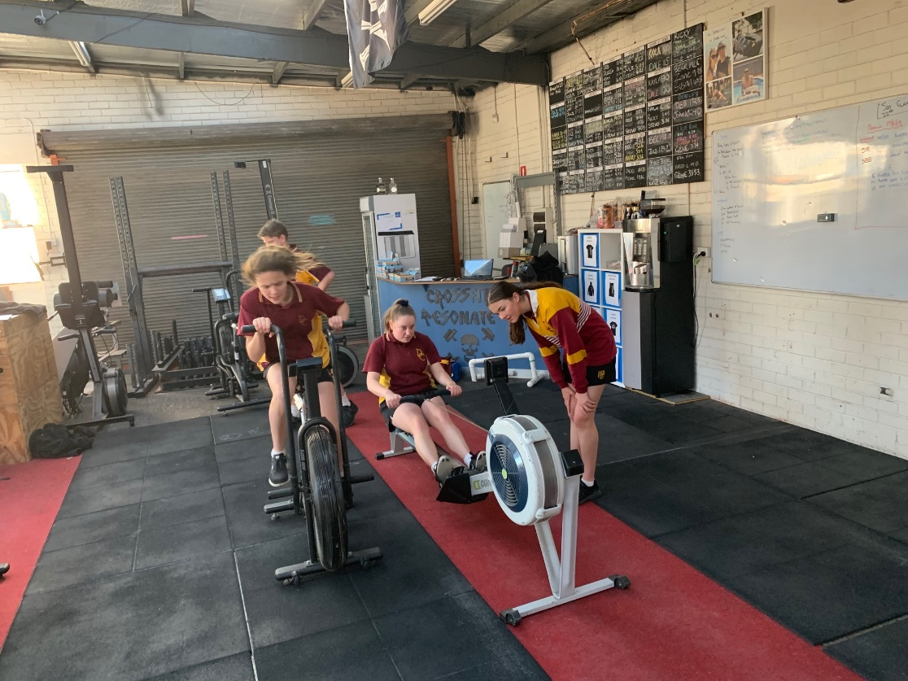
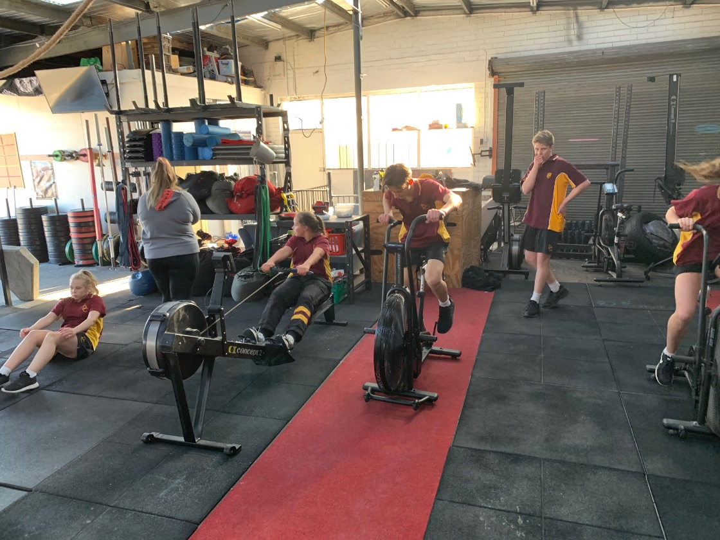
Engaging Activities
Highly practical on-site Athletic Development lessons.
Students will be introduced to a wide variety of local health and fitness businesses:
Health and Fitness
Spin classes
Crossfit
Unracked
Boxing
MMA
Bikram Yoga

Slide 9
Find out more…
Please feel free to contact Mr Cameron Golding, Director of HPE, at cgolding@dominic.tas.edu.au

